Slide 1




September 11, 2025
Taunggyi Directory
(Mobile Application)
Internship Project Presentation
Presented by:
Mg Ye Htet San (5CS-37)
1

Slide 2

Introduction
Objectives
Project Overview
System Flow
Use Case Diagram
ER Dragram
Development Environment
Challenges and Limitations
Future Enhancements
Conclusion
Contents
2

Slide 3
Internship role: Mobile Application Developement (Flutter)
Focus:Flutter ,Dart, FastAPI backend , SQLite
Gained:Practical coding experience, real project workflow,teamwork, and problem solving
Introduction
3

Slide 4
To develop mobile app (Taunggyi Directory) to guide users to places in Taunggyi.
To provide admin dashboard for management (places,users,categories,ads).
To ensure user experience with search, reviews, favorites, and profile customization.
Objectives
4

Slide 5
Mobile app for discovering places, food, and locations in Taunggyi.
System has two sides: User and Admin
User side: Login/Sign up, browse/search places, give review and rating, add to favorites,view locations on map, profile,settings.
Admin side: Login,manage places, categories, users , ads, and events.
Project Overview
5

Slide 6
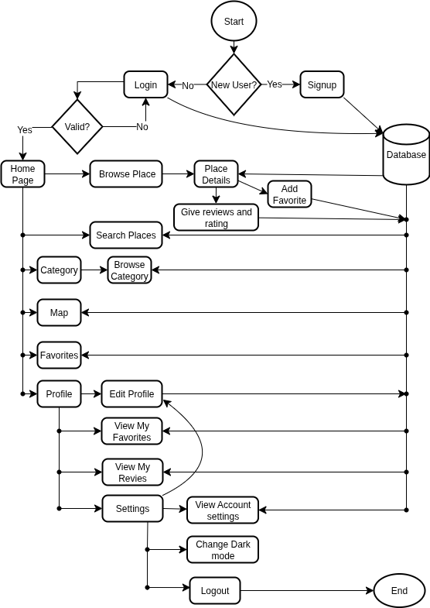
System Flow
User flow diagram
6

Slide 7
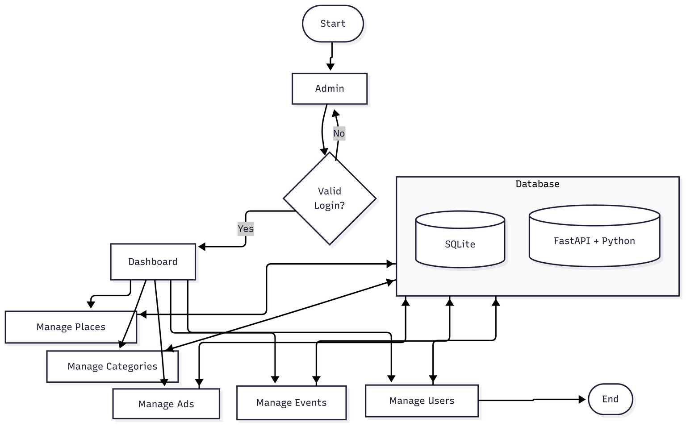
System Flow
Admin flow diagram
7

Slide 8
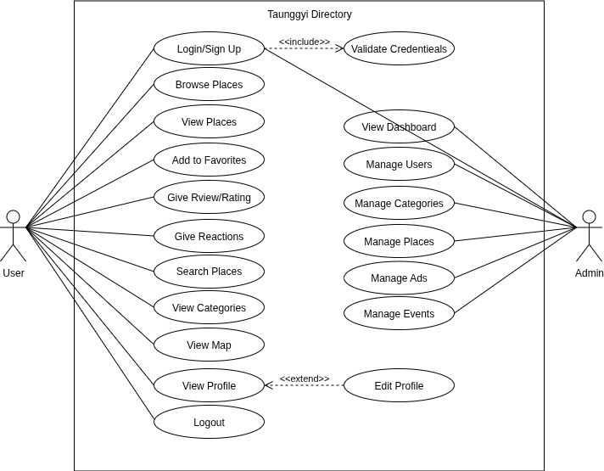
Actors:
User
Admin
Use Case Diagram
8

Slide 9
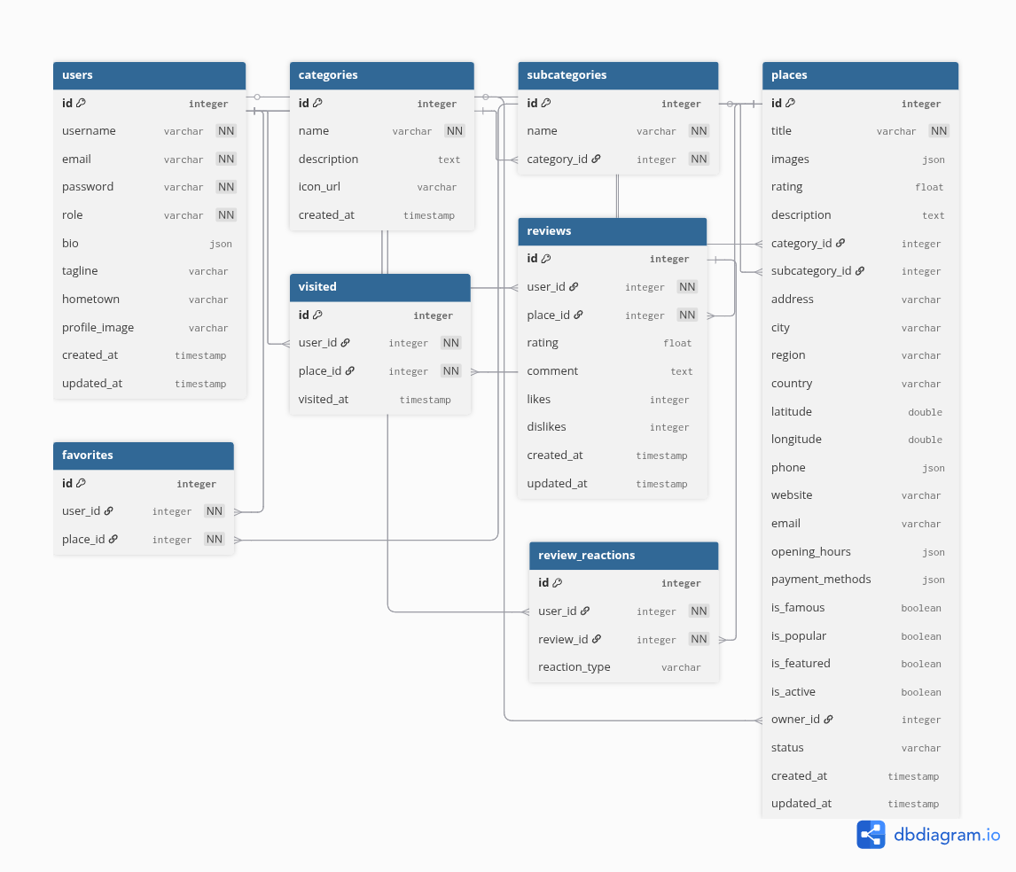
Database Entities
Users
Places
Categories
Favorites
Subcategories
Reviews
Visited
Review Reactions
ER Diagram
9

Slide 10
Frontend(Mobile App)
Flutter, Dart
Riverpod, Go Router
SharedPreferences, Secure Storage
Google Maps, Carousel Slider, Rating Bar
Backend (Server)
Python + FastAPI
SQLite Database
Uvicorn Server
Tools
VS Code, GitHub, Android Device
Development Environment
10

Slide 11
Device Limitations: Limited to testing on my personal Android device
Time Constraints: Could not finish Admin Ads Management and Event Management before deadline.
Backend Challenges: Debugging FastAPI & Flutter integration
Learning Curve: First time working deeply with Riverpod, GoRouter, and Google Maps integration.
UI/UX Refinement: Limited time for improving responsiveness, theme customization, and polishing the interface.
Challenges and Limitations
11

Slide 12
Complete Ads & Event Management
Add Forgot Password & Multi-language support
Improve UI/UX with more animations
Implement push notifications
Improve map performance for smoother navigation
Cross-device testing (iOS, tablets)
Future Enhancements
12

Slide 13
Conclusion
My internship at Widget-Lab provided valuable hands-on experience in Flutter, Dart, FastAPI, and mobile app development. I gained practical skills in building a real-world project, working with APIs, SQLite, and managing state with Riverpod. The experience improved my problem-solving, debugging, and teamwork abilities, while giving me a clearer understanding of professional software development. Overall, this internship has strengthened my technical knowledge and prepared me for future challenges in the tech industry.
13

Slide 14
Thank You
14

Slide 15
Q & A
15

